Slide 1
One Hundred Words

Slide 2
The value of words
§§ Developing vocabulary to give
better understanding of other words
§§ Developing links to emotion words for
faster vocabulary building
§§ Developing better verbalization of
emotion in conversation.

Slide 3
Emotion accounts for a large part of communication.
Therefore the need to understand the emotional values of words is vital for communication in ANY language.

Slide 4
The idea behind the 100 words is to ....
know how many words or depth of vocabulary a student has.
use the words to give emotional values to the words from a base.
This will help the student think about each word differently.
It is not just a word but a value to a
conversation and communicates values to
the rest of the words.

Slide 5
Therefore, the last page in this 100 Words section challenges the student to think about the emotional values of word they use. After this is worked through, the continued emphasis on these four areas which are critical to good communication.

Slide 6
Categorizing Words
On the next page write down 100 words that you know.
1 - 25 use words that help you communicate TIME.
26 – 50 use words that help you communicate Basic ACTION.
51 - 75 use words using “ing” or
MOVING words.
76 - 100 use words that tell
EMOTIONS.

Slide 7
Time
week
often
1.__________
2.__________
3.__________
4.__________
5.__________
6.__________
7.__________
8.__________
9.__________
10._________
11._________
12._________
13._________
14._________
15._________
16._________
17._________
18._________
19._________
20._________
21._________
22._________
23.________
24._________
25._________
hour
soon
minute
later
for
Friday
sometime
about
holiday
frequently
any
O’clock
always
by
day
forever
before
vacation
many
at
weekend
no time
around

Slide 8
Action
dig
26._________
27._________
28._________
29._________
30._________
31._________
32._________
33._________
34._________
35._________
36._________
37._________
38._________
39._________
40._________
41._________
42._________
43._________
44._________
45._________
46._________
47._________
48._________
49._________
50._________
place
play
over
watch
talk
to
dance
move
by
jump
push
belch
run
skip
slurp
walk
hug
lurch
study
tie
jaunt
speak
drink
fool around

Slide 9
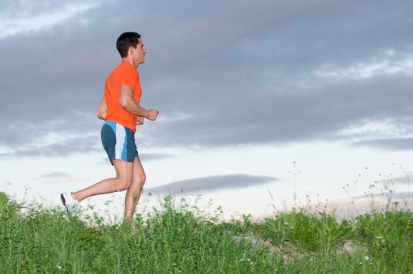
Motion
sliding
forward
51._________
52._________
53._________
54._________
55._________
56._________
57._________
58._________
59._________
60._________
61._________
62._________
63._________
64._________
65._________
66._________
67._________
68._________
69._________
70._________
71._________
72._________
73._________
74._________
75._________
seeing
backward
shouting
upward
droop
shopping
sideways
clenched
speaking
toward
careen
helping
away from
bend
eating
going to
lope
studying
side to side
stream
taking
to the next
slink

Slide 10
Emotion
76._________
77._________
78._________
79._________
80.___________
81._________
82._________
83._________
84._________
85._________
86._________
87._________
88._________
89._________
90._________
91._________
92._________
93._________
94._________
95._________
96._________
97._________
98._________
99._________
100.________
angry
lonely
happy
thoughtful
surprised
curious
envious
shy
puzzled
blue
embarrassed
miffed
ecstatic
sad
anxious
apathetic
love
annoyed
alienated
careful
depressed
hysterical
proud
shocked
paranoid

Slide 11
Writing Basic 1 ~~ Step 1
Choose one (1) time/ action/ motion /emotion word from the list. Write them in the boxes.
u Hour / play / hitting /hard
Now you do 3 more from your list
v
w
x

Slide 12
Writing Basic 2 ~~ Step 2
Step 2 Make a sentence with each of the four words.
Write them in the boxes below.
You can mix the order of the words to help you.
u At five o'clock I play baseball, hitting the ball hard.
Try three by yourself
v
w
x
Step 3 Read them out loud in front of the class.

